Slide 1
Source code generation
Submitted By:-
Aashay Gandhi
Aayush Bhatt
Akshay Chauhan Internal Guide:-
Jaimin Raval Prof. Riya Gohil

Slide 2
Description
Technology Used-
Java 8, AWS, MySQL, Alexa.
What Purpose Project Solve?
Our project provides Developers a option to make Web pages for performing CRUD operations by providing code to them from the input which we take as field name and field type name and can run on their own system.
How Project Works?
It uses Alexa to get input from the user such as project name, modules and forms, then generate the code as per the input and store the code in AmazonS3 then the code generated is mailed to the user on their registered email. Then the user can run the code on his system in Eclipse IDE by using his database.

Slide 3
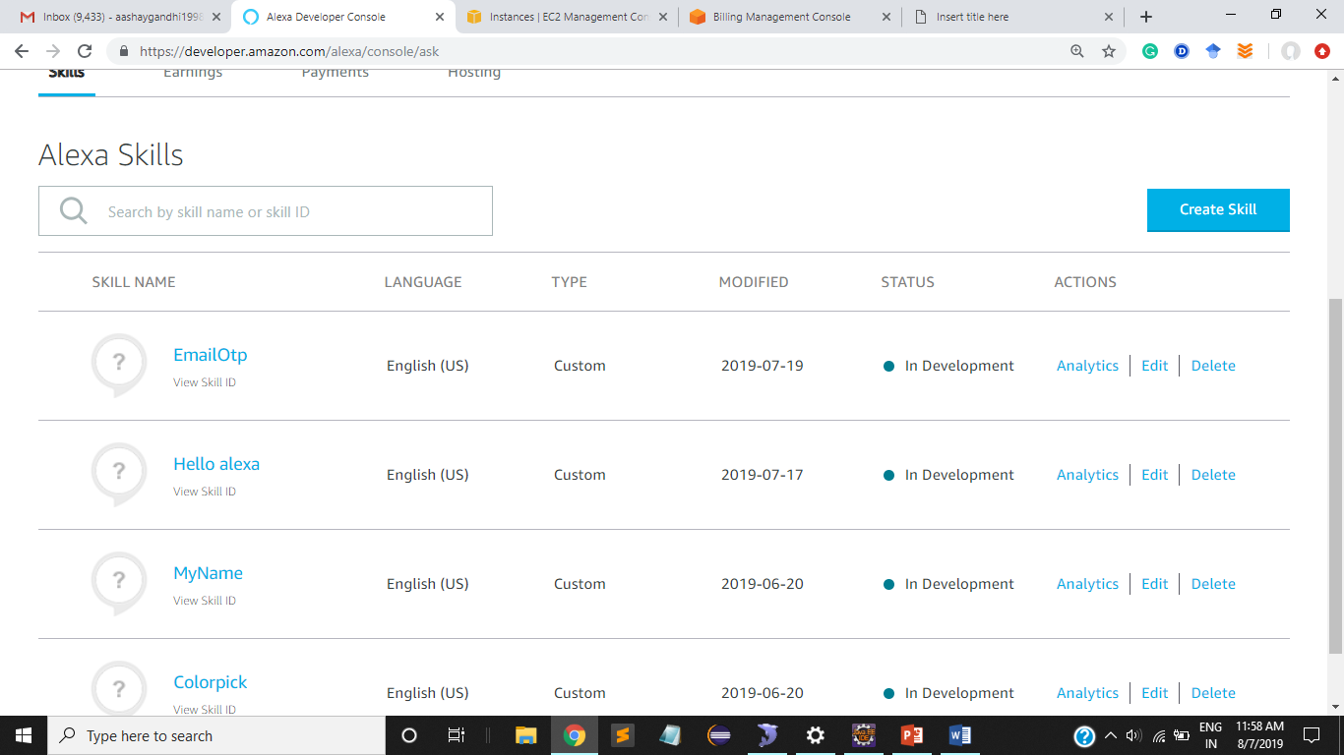
Working and process step by Step:-
Alexa
This page is the homepage of Alexa skill set here the skill to implement is created by clicking “Create Skill” which is used for implementing Alexa as interface.

Slide 4
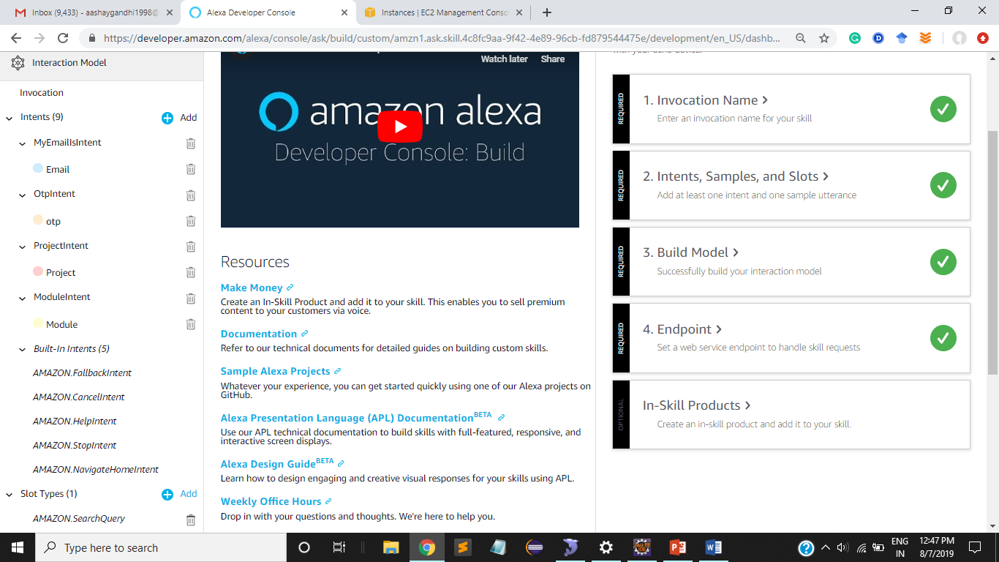
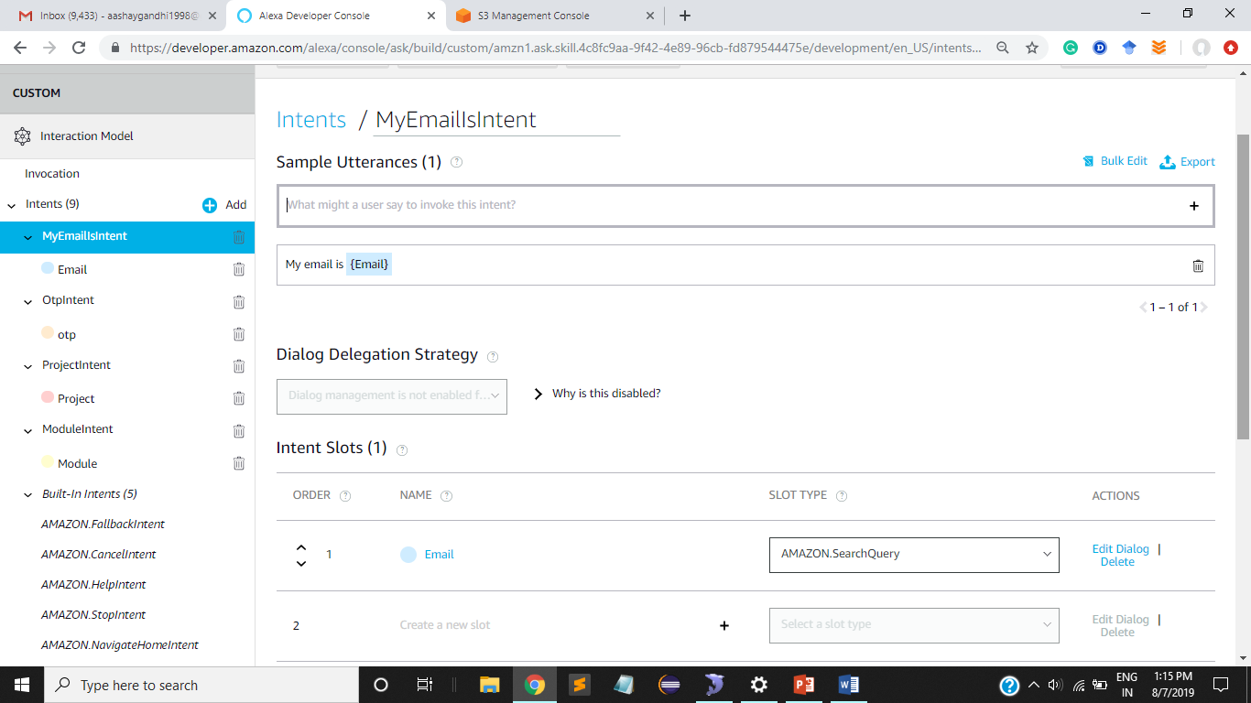
In this the figure 1 represents the built in intent and the created intent it also has invocation name which is used to start the skill set.
In figure 2 we create a intent and add a utterance which is used to get Alexa understand the sentence and give appropriate response to it and slot is created to store the dynamic value entered by user.

Slide 5
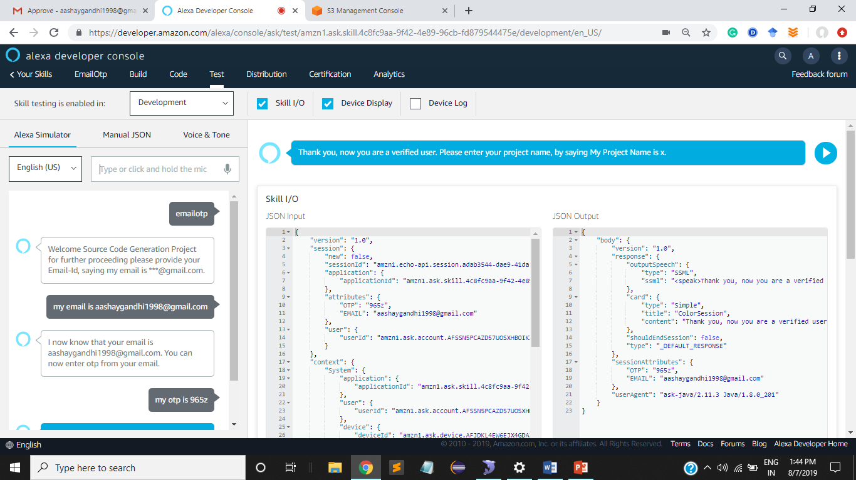
In this the figure shows the activation of Alexa skill by using invocation name for e.g.- emailotp.
Then the user enter email as per given instruction and then the otp is send to the entered e-mail to verify it.

Slide 6
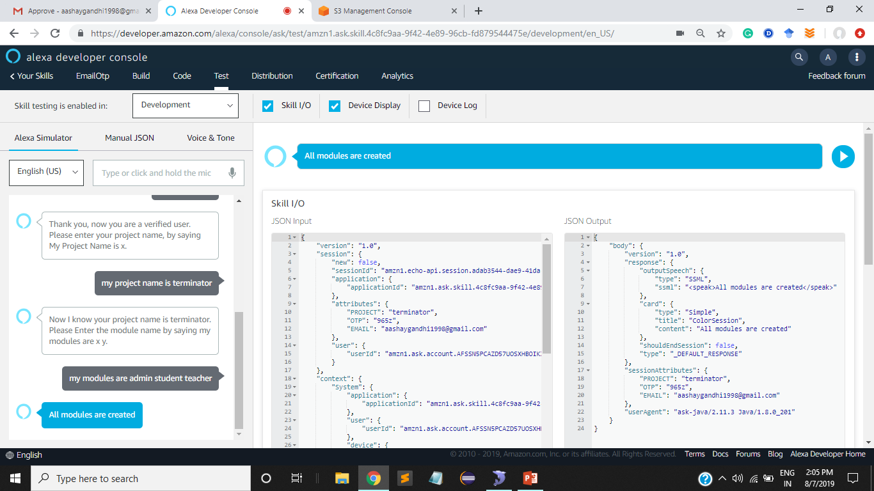
In this the figure shows after verification we enter the project name as per we are told by alexa.
Then we enter module name to be created for the system and then this whole thing is stored in Amazon S3 in the form of folder.

Slide 7
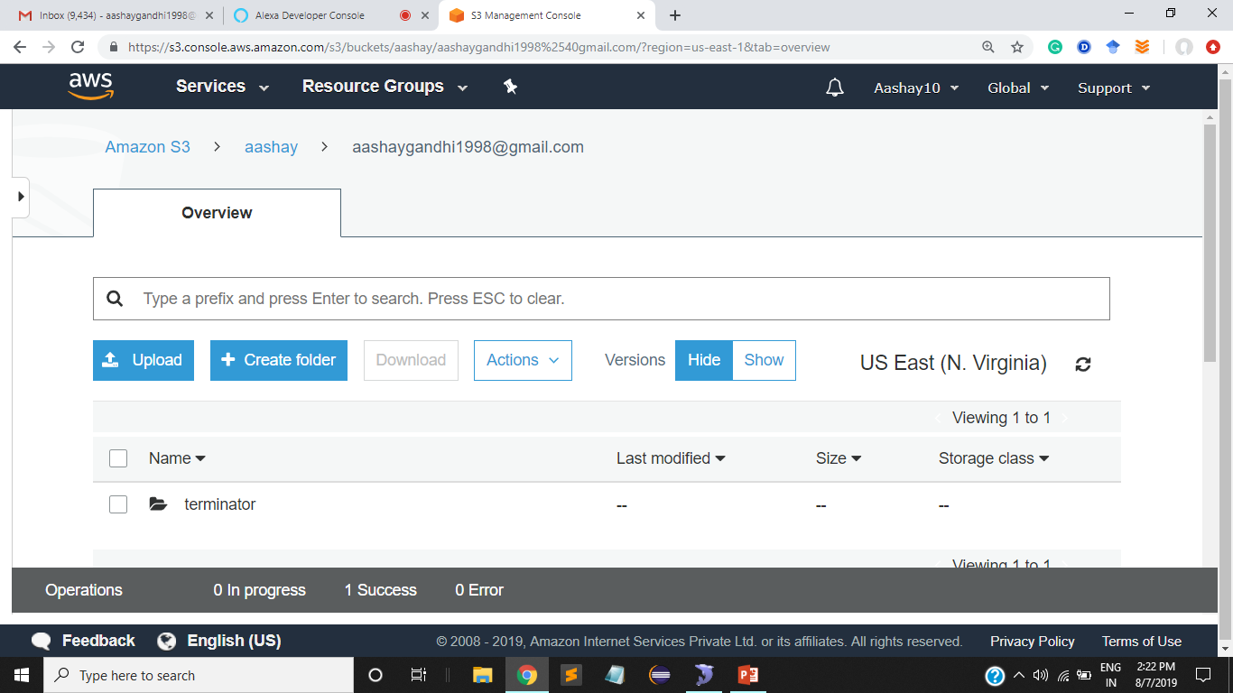
Amazon s3
In this the figure the we store the project name inside the folder of email id.
To store something in S3 we have to create a bucket in which we can store the whole project in it.
The flow of system is bucket_name->e-mail _id->project_name.

Slide 8
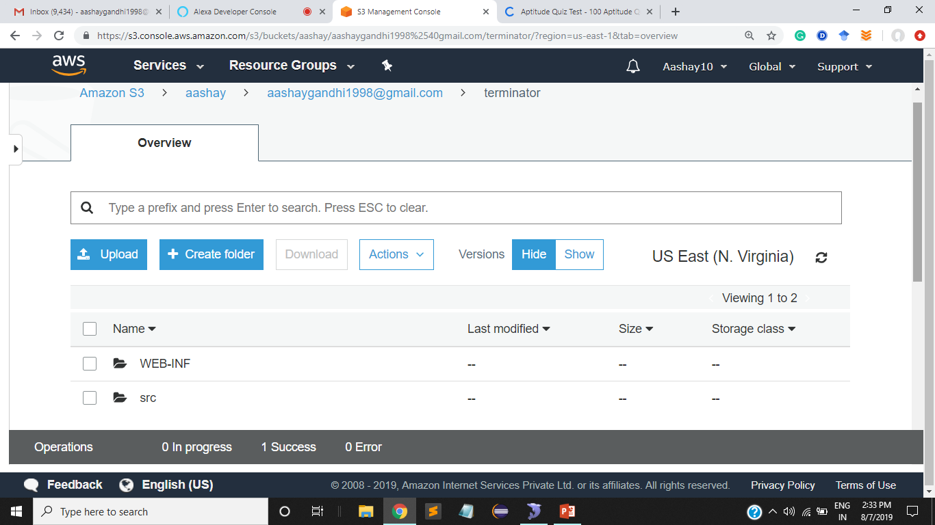
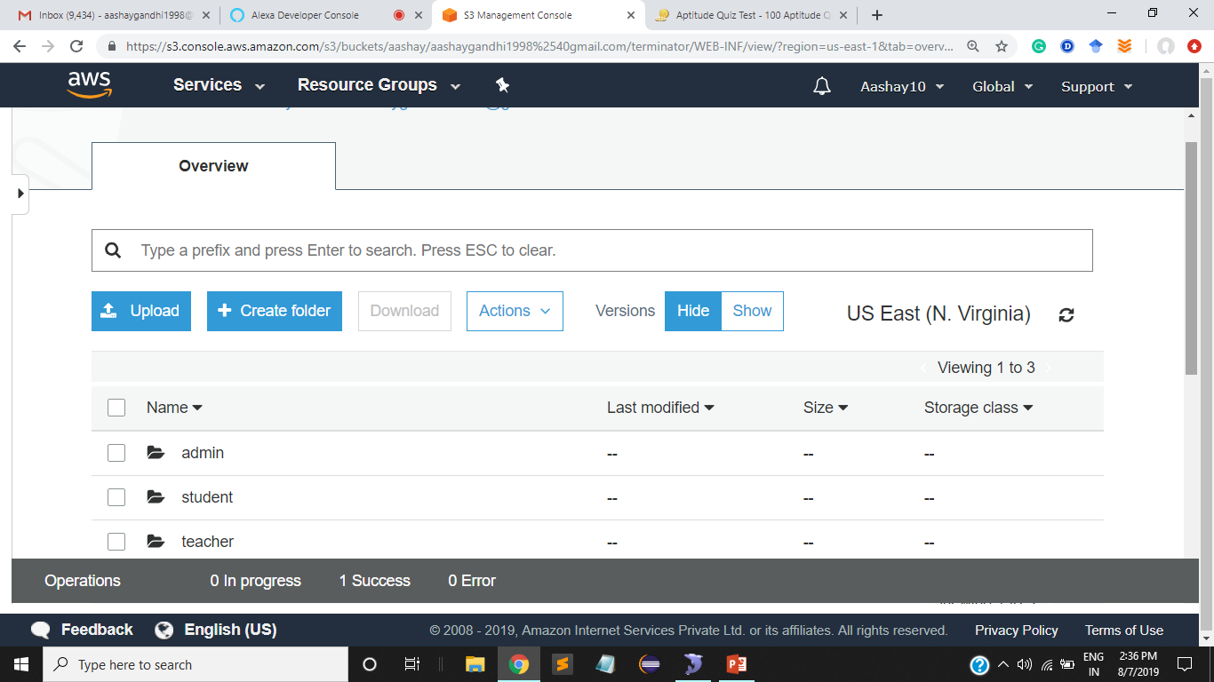
In this the figure 1 there are two folder in project WEB-INF and src. This folder are for storing web pages of modules and storing the backend logic of system respectively.
In figure 2 the WEB-INF contain view folder in it we have modules created such as admin, student, etc. it contain the webpages of system which are generated by the system.
Flow of WEB-INF is WEB-INF->view->admin, user.

Slide 9
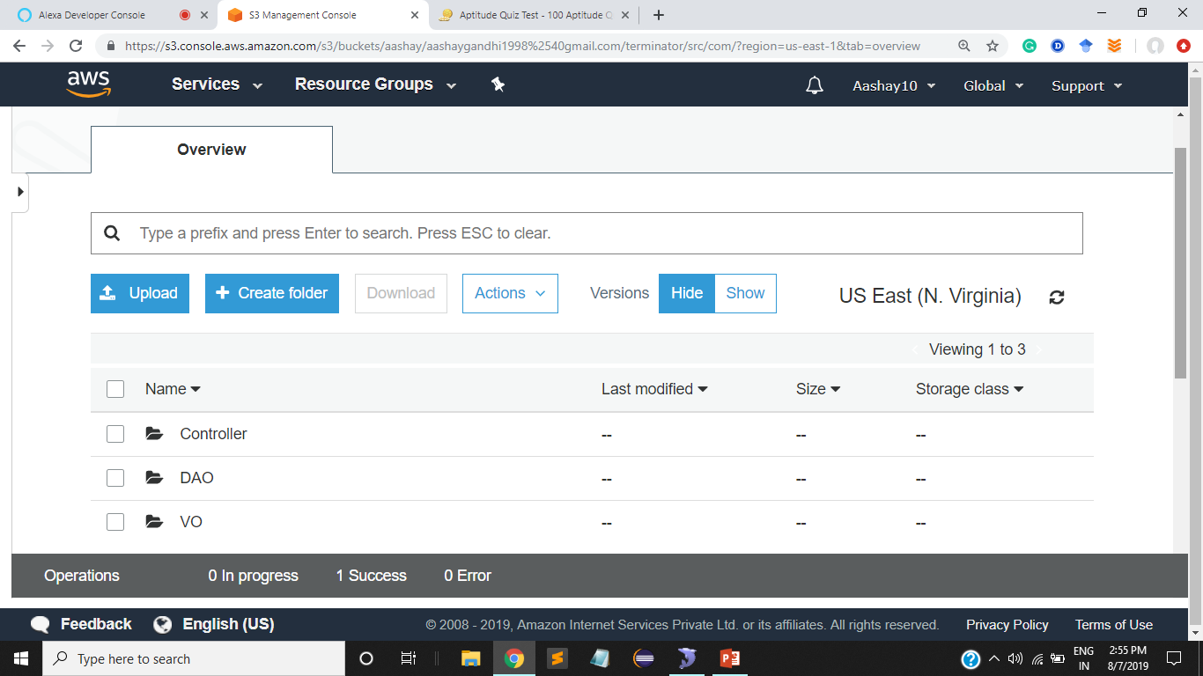
In this the figure 1 there are two folder in project WEB-INF and src. This folder are for storing web pages of modules and storing the backend logic of system respectively.
In figure 2 the src which is called the source folder contain folder name com in it , it has Controller, DAO and VO. In which we write the logic of database, redirecting pages and create encapsulated data.
Flow of src is src->com-> Controller, DAO, VO.

Slide 10
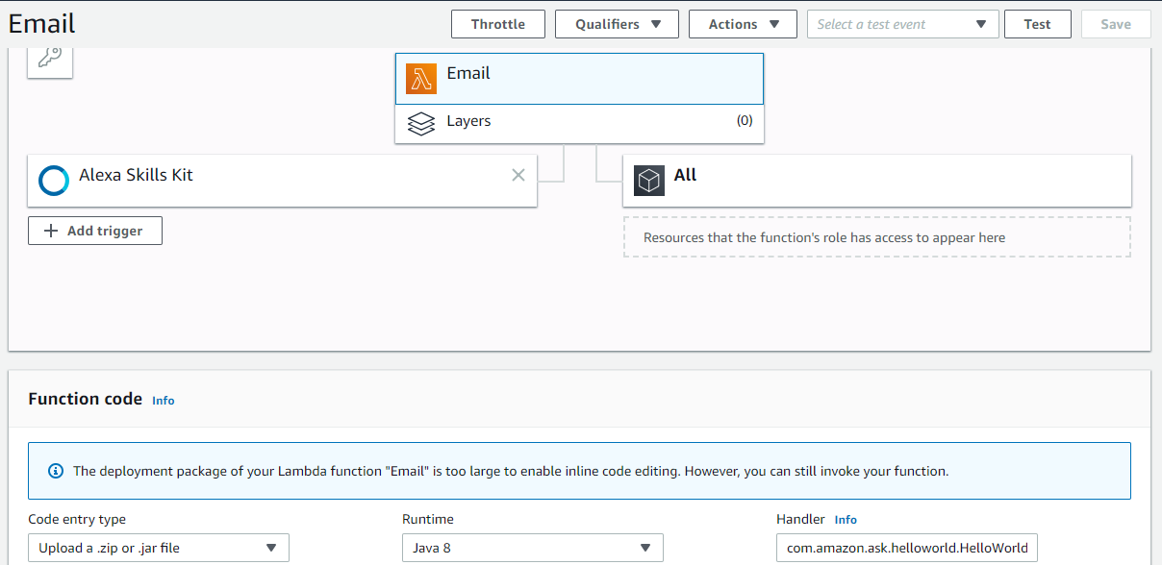
Amazon Lambda
To run the Alexa we first need to upload the code in the Amazon Lambda through which we run the code which does is server less computation of the system.
In figure the “Email” is function name and the “Alexa skill set” is a trigger which is used to tell where we want the code to run.
The function code is uploaded in two ways through s3 or by uploading through pc and select the runtime environment for the code which can be any java 7, java 8, python 3,etc.

Slide 11
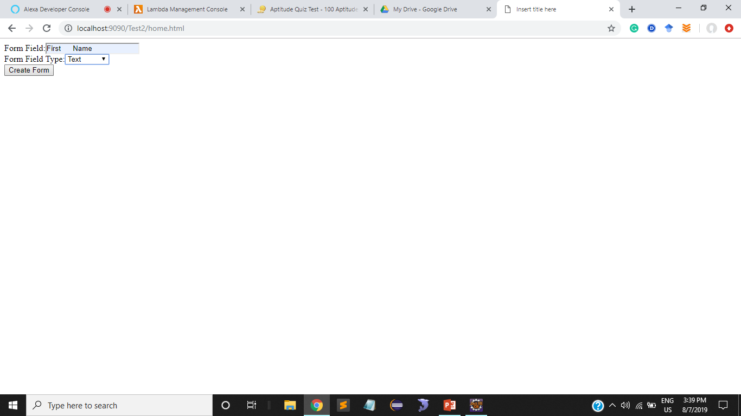
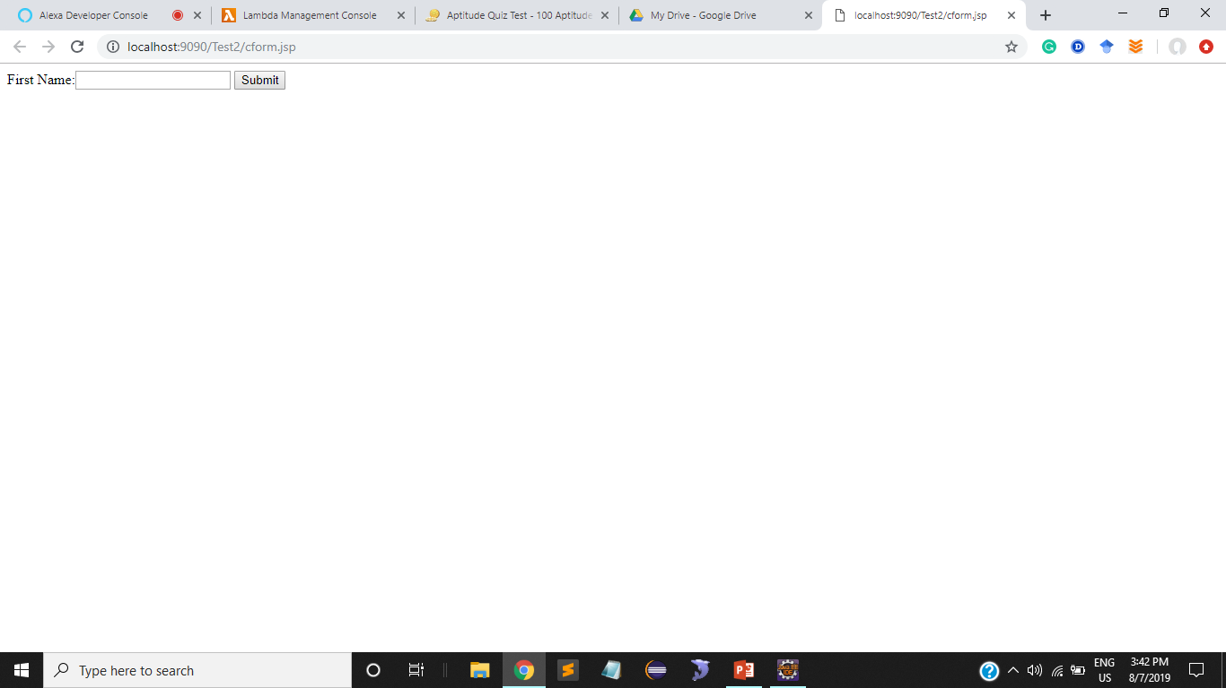
Code generation
To run the Alexa we first need to upload the code in the Amazon Lambda through which we run the code which does is serverless computation of the system.
In figure the “Email” is function name and the “Alexa skill set” is a trigger which is used to tell where we want the code to run.
The function code is uploaded in two ways through s3 or by uploading through pc and select the runtime environment for the code which can be any java 7, java 8, python 3,etc.

